Slide 1


The Behavior Engine for Direct Selling
PM International Segmentation Report
July 2017
www.DirecTechLabs.com

Slide 2
Objective
CASE BACKGROUND
PM International as well as the direct selling industry is battling with high churn, especially in the first 90 days of a customer’s lifecycle.
PM recognizes the huge revenue opportunity of retaining existing customers/TPs and would like to identify medium-high value reps that are likely to churn and devise the strategies to retain them.
Understanding of main drivers of churn will help PM in devising the right strategies.
PROPOSED SOLUTION
BUSINESS IMPACT
Customer Segmentation - Separate the customers with similar behavior patterns in distinct groups
Prediction models – Leverage predictive models for each group to find the probability of churn
Churn reduction will increase the customer base and can significantly increase revenues
Homogenous segments will also be helpful in understanding the customer base and will allow marketing to target specific groups.

Slide 3
3 Step Analytical Framework for Churn Prediction
Segmentation – Know your customers
Identification of homogeneous customer segments
Understanding the patterns & profiles of customers in each segment
Prediction – Churn Probability of each customer
Prescriptive Analysis - Whom to Retain?
Identify the high risk customers in each segment and target them with personalized strategies.
Use statistical techniques to identify customers who are most likely to churn
Identify the influencing factors for each customer.
Calculate current customer value to date as well as future value
1
2
3

Slide 4
Data variable examples used
Total Customer Base
1,090,349
Actual Customers or TPs
1,083,865
Created before June 2016
1,008,127
Customer with either Sales, Commissions or Network Addition
518,901
Customers Created Since 2012
401,985
Customer with at least 1 Euro of Sales
378,821
Customers Base
Sales Orders
Commission & Payout
Age – Only Considered Age between 20 to 70, rest of the data doesn’t appear realistic
Mandator – Remove these from analysis since they are not actual customers
PayoutEur – Use standard Euros currency for commission payout
Gender – Based on Salutation, Derive the Gender of a Customer or TP
Document Type – Only Orders have been considered
Calculation Date, Period – To find when and for which Period Commission has been Paid
Document State – Cancelled orders have been removed
Subscriptions
Number of Customers Used for the analysis
Customer Network History
Table and Fields Used for the analysis
Order Date – Necessary to get Order Creation Date
We look at the customers and TPs who have active subscriptions
Sponsor, Customer Number, Start Date, End Date, Quali Level –
Used these columns to find the current and historical Quali Levels.
Used columns to find the network recruitment and size
Total Points GV – We need standard currency value across markets so we use EUROs
E-Business Logins
Sales Orders Details
We look at who and how often people login.
Product – Due to thousands of product name permutations, we cannot summarize by product.

Slide 5
Customer Segments

Slide 6
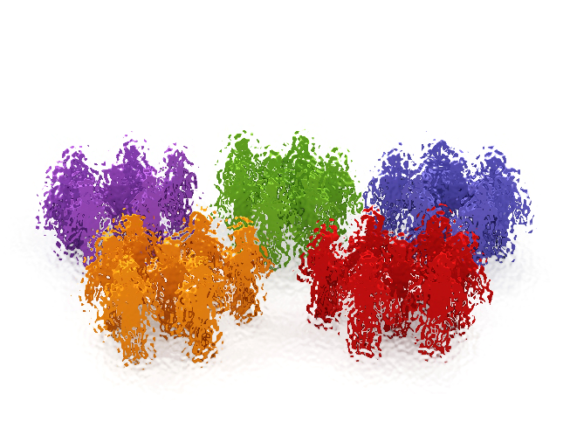





Segmentation framework will identify different persona of customers
Identifying the Dimensions
Age & Gender
Transaction History like Sales, Discount Rate
Network Growth
Subscriptions
Commissions
Rank Growth
Statistical techniques such as K-Means clustering has been used for Segmentation
Segmentation
Business Builders
Performing Female Customers
Average Male Performers
Poor Female Performers
Generate High Sales
Receives Commissions
Adds Network
92% had subscriptions
Generate Avg. Sales
94% Had Subscriptions
All Place Second Order within first 6 months
Below Average Sales
70% had subscriptions
64% place second order within first 6 months
Doesn’t generate sales after one month
Profiling & Base Strategies
High Value
Medium Value
Low Value
# of Customers
77,521 (18%)
158,920 (36%)
112,805 (25%)
89,385 (20%)
Sales & Commissions
in Year 2016
55%
97%
27%
1%
14%
2%
3%
0%

Slide 7



Further Segmentation of Business Builders into five distinct groups
Performing Female Customers
Average Male Performers
Poor Female Performers
Business Builders
Business Leaders
Top Sales Executives
Leaders
Network Builders
Casual Builders
# of Customers
285
(.07%)
3,669 (0.8%)
7,388 (1.7%)
43,050 (10%)
23,129 (5%)
% Sales in Year 2016
1%
8%
10%
24%
13%
% Commissions in Year 2016
38%
26%
10%
18%
5%
Commissions Per Customer in Year 2016
€
74,000
€
4,707
€
1,073
€
576
€
228

Slide 8



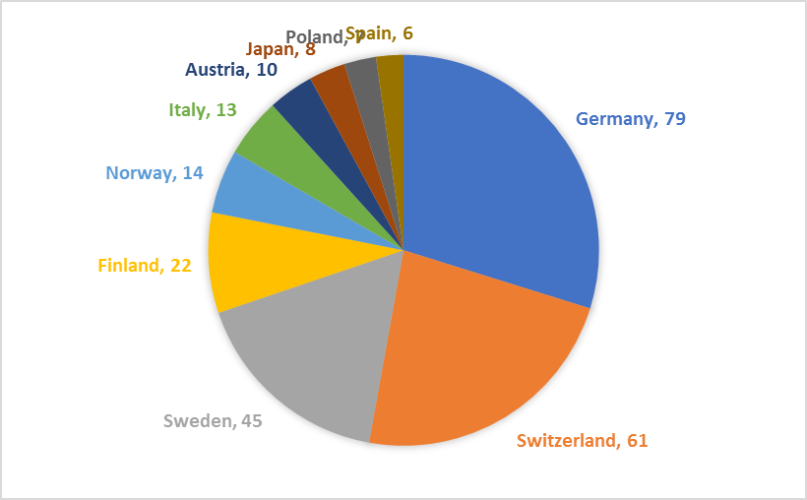



Business Leaders – Behavioral & Demographical Traits
Average 5 Year
Sales
Average 5 Year
Commissions
EUR 26,118
(Average of all customers - EUR 1,717)
EUR 276,385
(Average of all customers - EUR 1,873)
TP Added in
Last 5 Years
By each Leader
81
Business Leaders
31 % Male Customers
Numbers of TPs 285
% of Total customers
0.07%
63 % Female Customers
Active all these 5 Years

Slide 9

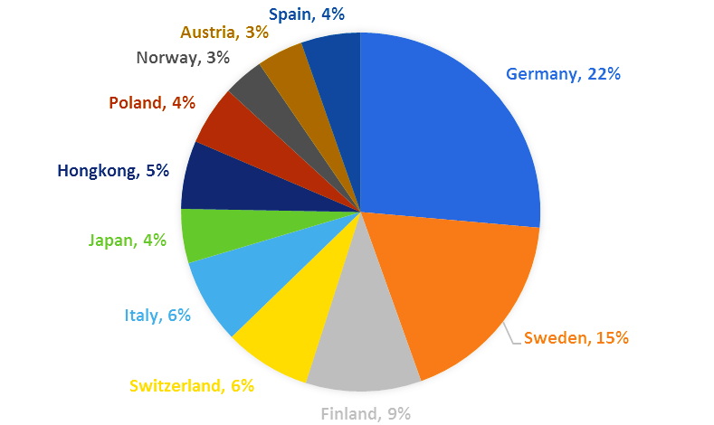
Top Sales Executives– Behavioral & Demographical Traits
5 Year Sales
5 Year Commissions
Improvement
in Quali Rank
Average 5 Year Sales
EUR 10,598
(Average of all customers - EUR 1,717)
Average 5 Year Commissions
EUR 8,231
(Average of all customers - EUR 1,873)
TP Added in
Last 5 Years
By each Leader
29
3.5
Top Sales Executives
32 % Male Customers
Numbers of TPs 3,369
% of Total customers
0.7%
67 % Female Customers
Active for 2.5 Years

Slide 10
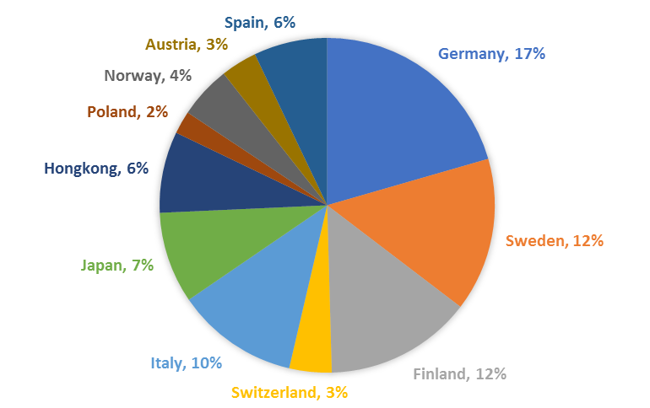
Leaders – Behavioral & Demographical Traits
5 Year Sales
5 Year Commissions
Improvement
in Quali Rank
Average 5 Year Sales
EUR 6,730
(Average of all customers - EUR 1,717)
Average 5 Year Commissions
EUR 2,070
(Average of all customers - EUR 1,873)
TP Added in
Last 5 Years
By each Leader
13
2
Leaders
31 % Male Customers
Numbers of TPs 7,388
% of Total customers
1.7%
69 % Female Customers
Active for 2 Years

Slide 11
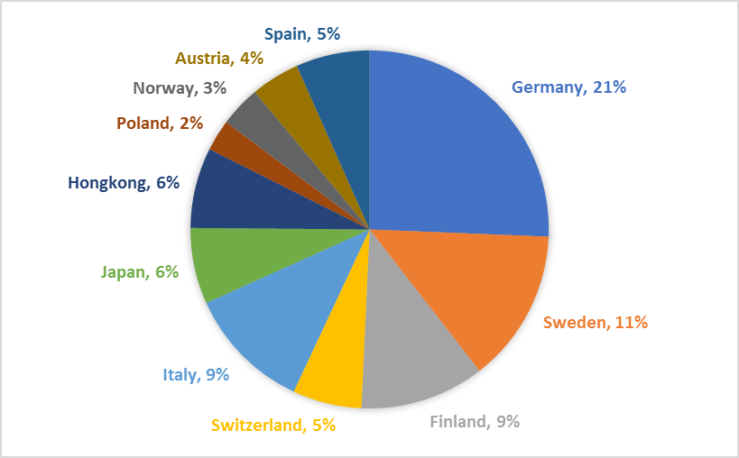
Network Builders– Behavioral & Demographical Traits
5 Year Sales
5 Year Commissions
Improvement
in Quali Rank
Average 5 Year Sales
EUR 4,688
(Average of all customers - EUR 1,717)
Average 5 Year Commissions
EUR 1225
(Average of all customers - EUR 1,873)
TP Added in
Last 5 Years
By each Leader
5
1
Network Builders
22 % Male Customers
Numbers of TPs 43,050
% of Total customers
10%
77 % Female Customers
Active for 2 Years

Slide 12
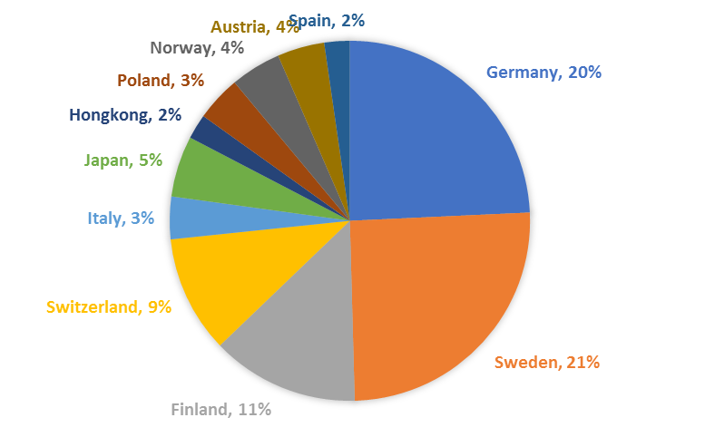
Casual Builders– Behavioral & Demographical Traits
5 Year Sales
5 Year Commissions
Improvement
in Quali Rank
Average 5 Year Sales
EUR 3,088
(Average of all customers - EUR 1,717)
Average 5 Year Commissions
EUR 370
(Average of all customers - EUR 1,873)
TP Added in
Last 5 Years
By each Leader
2
1.1
Casual Builders
21 % Male Customers
Numbers of TPs 23,129
% of Total customers
5%
78 % Female Customers
Active for 15 months

Slide 13
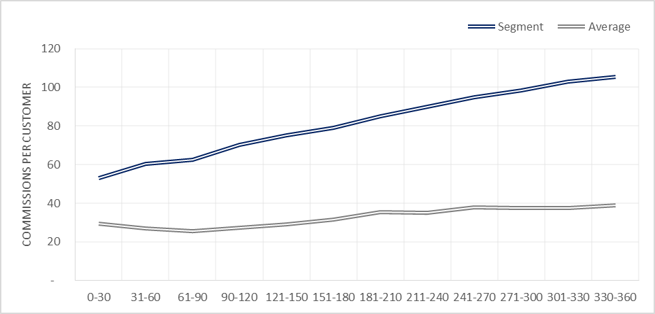
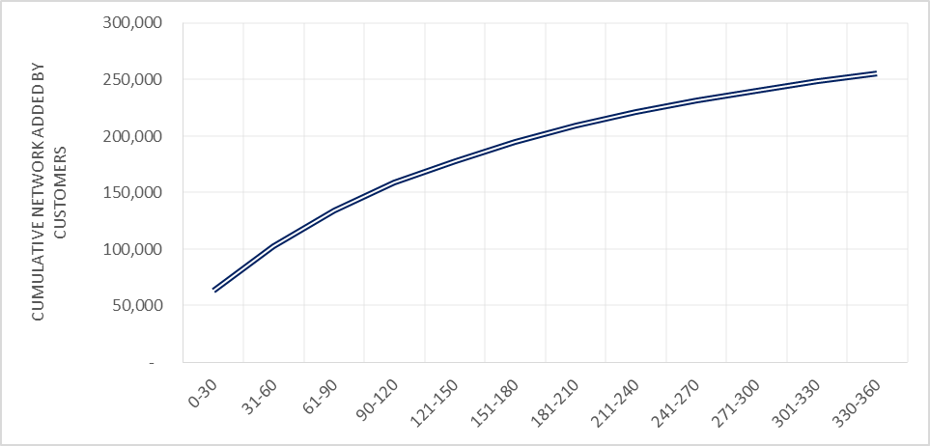
Evidence of Behavioral Traits of Segment 1 from Commissions & Network
Average Commission Per Customer
Cumulative Network Added by Customers
As can be seen from above graphs, Commissions per Business Builder is increasing as TP’s tenure is increasing at PM
From second graph, Business Builders in this segment are going the extra mile to increase their network

Slide 14

Business Builders – Recommendations
18% of total customers
Premium Business Partners
Doing Sales, Earning Commissions
Growing their network
Continuously improving their Quali ranking
92% had subscriptions
98% get commission in first 90 days
Segment 1
RECOMMENDATION
Business Builders
WORK IN PROGRESS

Slide 15

Valuable Female Customers– Behavioral & Demographical Traits
5 Year Sales
5 Year Commissions
Improvement
in Quali Rank
Average 5 Year Sales
EUR 1,472
(Average of all customers - EUR 1,717)
Average 5 Year Commissions
EUR 236
(Average of all customers - EUR 1,873)
TP Added in
Last 5 Years
By each Leader
1
0.9
Valuable Female Customers
<1 % Male Customers
Numbers of Customers 158,920
% of Total Customers
36%
99%+ Female Customers
Active for 11 months

Slide 16
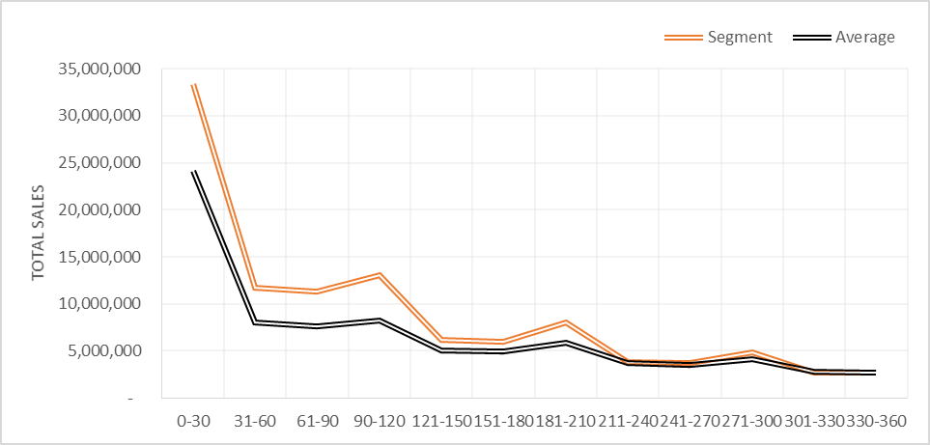
Evidence of Behavioral Traits – Female Performers
Customers in this segment does above average sales and completely outperforms average customers.

Slide 17
Female Performers – Recommendations
35% of total customers
All Females
Highly Valuable segment
Doing good amount of Sales
94% have active subscriptions
Only 2% added network in 90 days (mostly regular customers)
Always place 2nd order within six month after placing first order
Segment 2
RECOMMENDATION
Valuable Female Customers
WORK IN PROGRESS

Slide 18

Average Male Performers – Behavioral & Demographical Traits
5 Year Sales
5 Year Commissions
Improvement
in Quali Rank
Average 5 Year Sales
EUR 1112
(Average of all customers - EUR 1,717)
Average 5 Year Commissions
EUR 400
(Average of all customers - EUR 1,873)
TP Added in
Last 5 Years
By each Leader
3
0.9
Average Male Performers
99%+ Male Customers
Numbers of Customers 112,805
% of Total Customers
25%
<1 % Female Customers
Active for 9 months

Slide 19
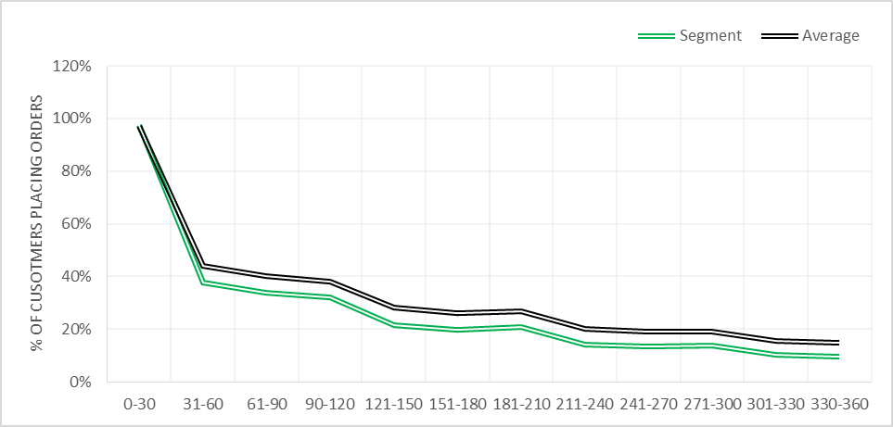
Evidence of Behavioral Traits of Average Male Performers
Performance of Customers in this segment is tad below average performance in terms of sales and orders.
Only 10% of total customers are placing orders after a year.

Slide 20
Average Male Performing Customers – Recommendations
25% of total population
Doing below average sales as compared to all the other customers.
71% had active subscriptions
93% doesn’t add network in first 90 days
64% placed second order within six months after placing first order
Only 13% upgraded their Quali level in their life time
Segment 3
RECOMMENDATION
Average Male Performers
WORK IN PROGRESS

Slide 21

Poor Female Performers– Behavioral & Demographical Traits
5 Year Sales
5 Year Commissions
Improvement
in Quali Rank
Average 5 Year Sales
EUR 271
(Average of all customers - EUR 1,717)
Average 5 Year Commissions
EUR 40
(Average of all customers - EUR 1,873)
TP Added in
Last 5 Years
By each Leader
0
0.8
Poor Female Performers
96%+ Female Customers
Numbers of Customers 89,385
% of Total Customers
20%
<1 % Male Customers
Active for 3 months

Slide 22
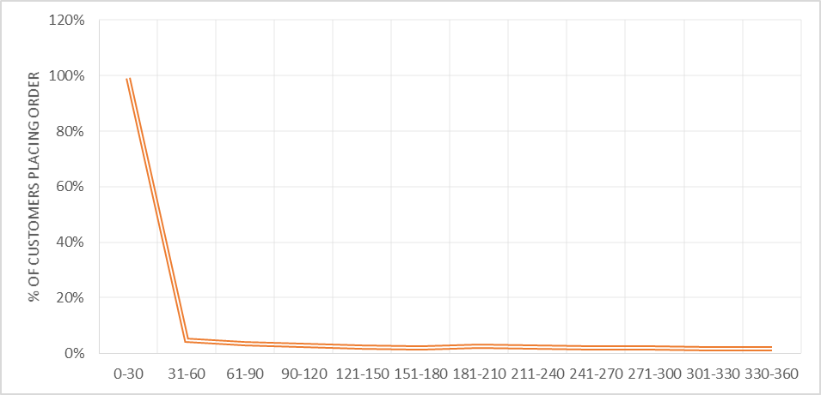
Evidence of Behavioral Traits – Poor Female Performers
Less than 5% customers in this segment place order every month after 30 days

Slide 23
Poor Female Customers – Recommendations
21% of total customers
Low value segment
Very Low Sales
88 % doesn’t place second order in next 180 days.
37% had active subscriptions
97% doesn’t add network in first 90 days
3% receives commission in first 90 days
Segment 4
Poor Female Performers
RECOMMENDATION
WORK IN PROGRESS

Slide 24
Data Insights

Slide 25
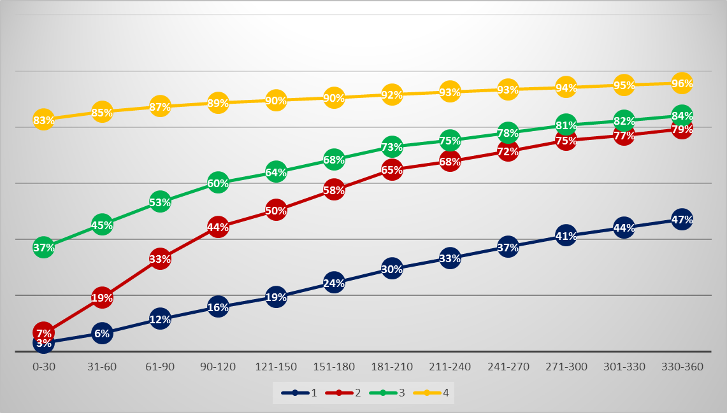
Churn Profiling
37% customers in this segment didn’t do any activity after 30 days
Customers who didn’t do any activity in last 90 days and never seen again will be considered as Churned

Slide 26
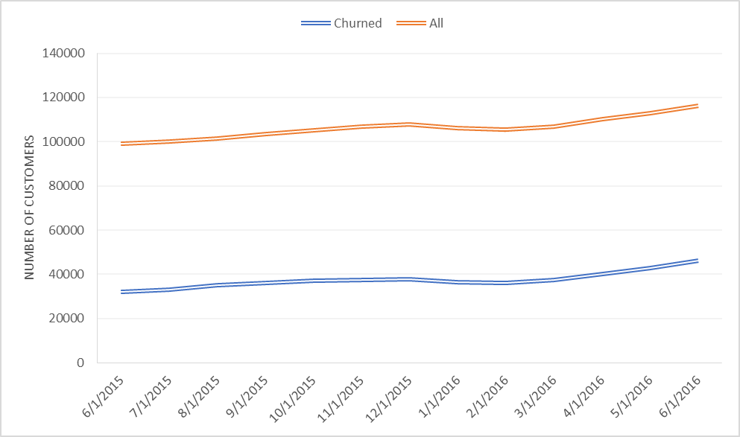
Active Customer Base v/s Churned Customers each Month
There are around 100,000 active customers each month and this base is increasing Month over Month.
32-35% Customers Churned each Month.

Slide 27
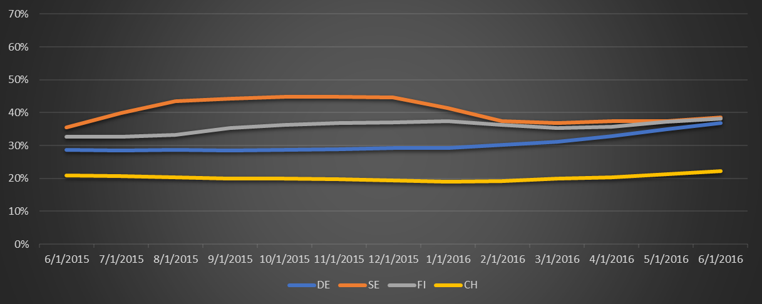
Churn Percentage Across Top Four Countries
Churn in Switzerland is low (20%) and very stable across months
Churn is Sweden has been reduced (45% to 37%) in recent months (Feb’16 – June’16)
Churn in Germany is also increasing linearly in first half of 2016

Slide 28
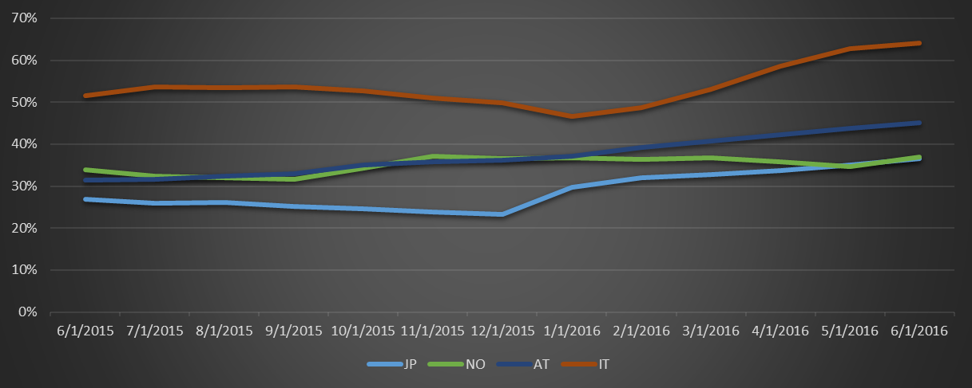
Churn Percentage Across Next Four Top Countries
Churn in Japan is low as compared to other countries although it is increasing in recent months.
Churn in Austria is linearly increasing over months.
Churn is Italy is very high and continuously increasing from starting of year 2016

Slide 29
Churn Percentage Across Age Groups
45% Customers in age group of 20-30 churned in the month of June’15
Customers with lower age has higher Churn

Slide 30
Appendix

Slide 31
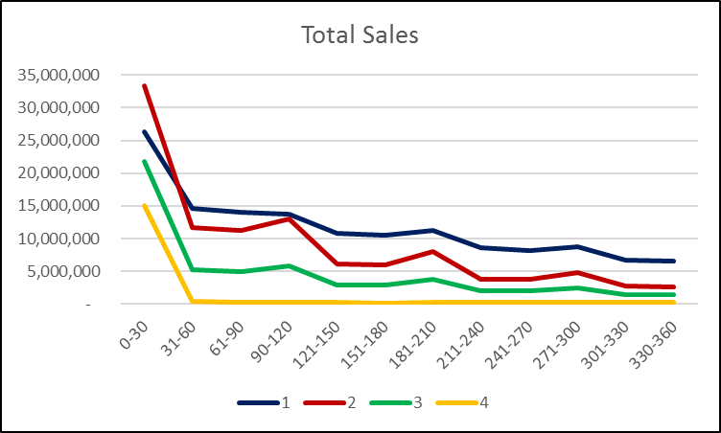
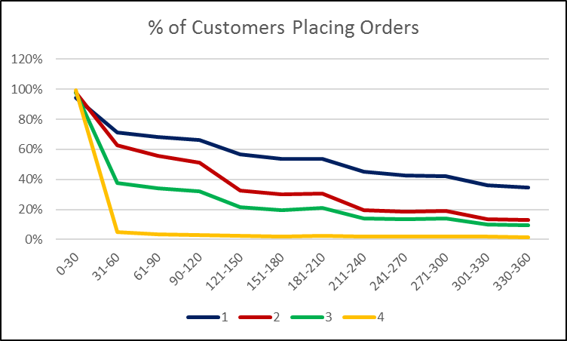
Evidence of Behavioral Traits from Sales & Order
Sales & Orders for cluster 4 is almost approaching 0 after 1 month
Cluster 2 has more sales and orders in 0-30 days than cluster 1 but then it start decreasing after 1 month
Notice the bump in sales in cluster 2 after three months and six months

Slide 32
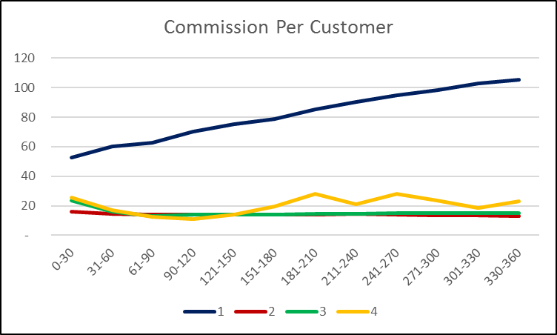
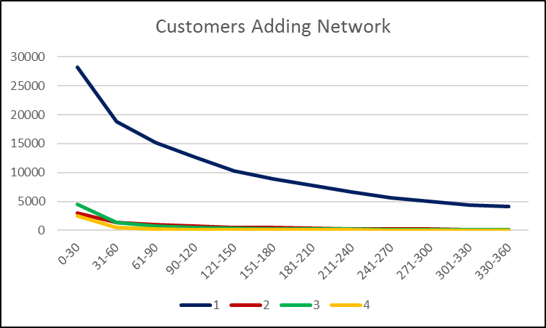
Evidence of Behavioral Traits from Commission & Network Expansion
Commission per customer in cluster 1 is growing as they are spending more time in the business. Working hard to expand their network.
Rest of the clusters are just not able to grow their business or not thinking at all about earning extra bucks
Some members of cluster 1 is going out of their comfort zone and adding customers after a year also.
Rest of the clusters gave up completely to grow their business.

Slide 33
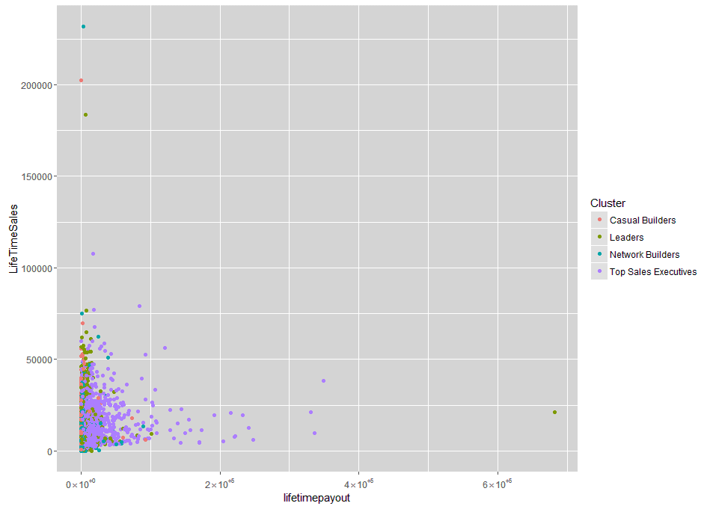
Distribution of 5 Year Sales & Commissions
TP with sales of EUR ~681,000 is an outlier
5 Year Commissions

